Slide 1
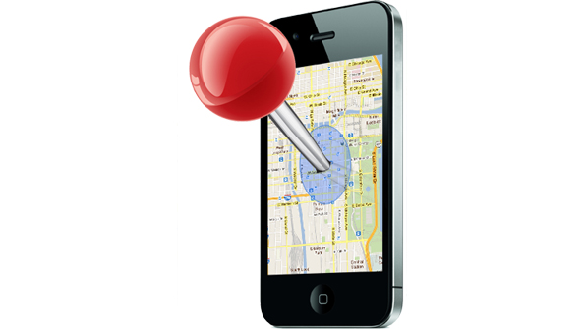
Intelligent Location Finder, Reminder & Alert generator

Slide 2
Agenda
To develop an android app that can locate the places that user needs such as nearest Bank, Gas Station, Hospital, Hotel, Movie Theatre, Restaurant, Supermarket etc.
This app can be used to set some reminders (notifications) based on a specific location, chosen from Google map.
Another interesting feature of this is app is a security alert generator module for women, which sends, location embedded alert messages to a number which already set in mobile, when user shakes the phone in a particular pattern.

Slide 3
Technologies used.
Android
Google Map Api v2
Google location Api
Google Places Api
Google Geo-fencing Api
Language used.
Java

Slide 4



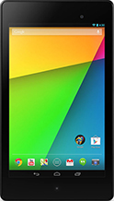
what is android?
Android is an open source Linux-based operating system designed for touch screen mobile devices such as smart phones, tablets and even watches and TVs.

Slide 5
why we choose android?
Users rapidly migrating from website to mobile phone
Android is free, open source and the most popular
Google products work best on android
Powerful, simple and beautiful
Fast application development in Java
Over 1.5 million android devices every day
More than 70 % of mobile developers are android developers

Slide 6
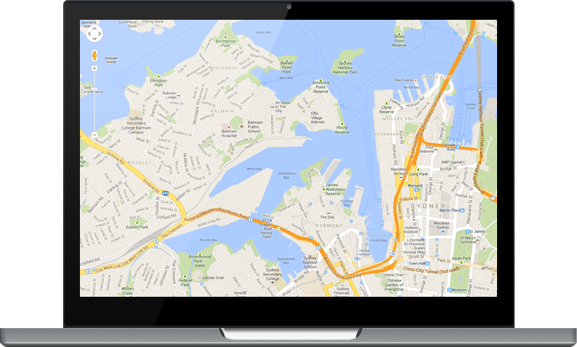
Google Map Api v2
Creating a map is nearly impossible. It help us to use the real Google map in our application.

Slide 7
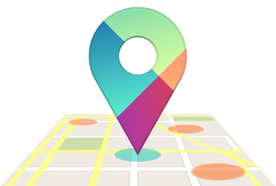
Google location API
The location APIs make it easy for you to build location-aware applications, without needing to focus on the details of the underlying location technology. They also let you minimize power consumption by using all of the capabilities of the device hardware. Also helps to find latitude and longitude from a location name.

Slide 8
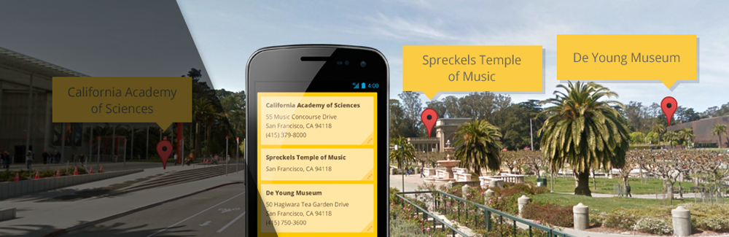
Google places API
Power your location-based app with the places API, which can be used to find detailed information about places across a wide range of categories. Backed by the same database used by Google Maps and Google+. Finds places from latitude and longitude.

Slide 9
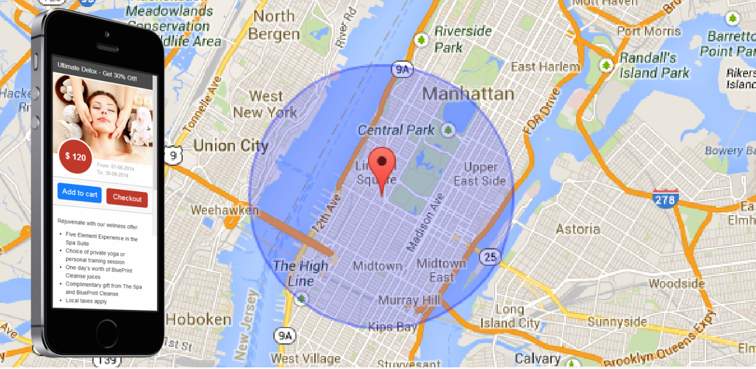
Geo-fencing API

Slide 10
Geo-fencing combines awareness of the user's current location with awareness of nearby features, defined as the user's proximity to locations that may be of interest.
To mark a location of interest, you specify its latitude and longitude. To adjust the proximity for the location, you add a radius.
The latitude, longitude, and radius define a geo-fence. You can have multiple active geo-fences at one time.
Location Services treats a geo-fences as an area rather than as a points and proximity. This allows it to detect when the user enters or exits a geo-fence.

Slide 11
Modules
-> Location Finding Module
-> Geo-fence Creation Module
-> Geo-fence Monitoring
-> Women Security Module
-> Server less Location sharing module

Slide 12
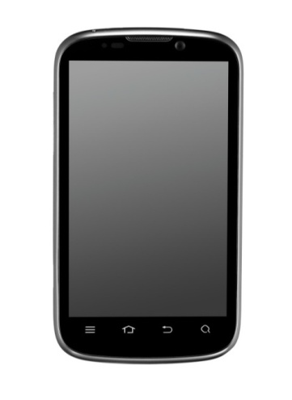
Project Logic
Step 1
Create an Android app with which is capable of finding the places that user demands.
We use Google places API for finding the places such as hotels, atm, bank, hospitals etc.
1.1
Create a clod project in google developer console and enable places api( cloud.google.com/console).

Slide 13
1.2
Places api receives input in latitude and longitude format. But Its hard for the user for typing the latitude and longitude rather than typing a location name.
1.3
So convert the location name that user types into its corresponding latitude and longitude. This process is reverse geo coding and done by the location Api
1.4
Generate a license key from google in order to use these facilities and make api call from android application

Slide 14
2.1
Make the app geo sensitive and create location based reminder by using Geo-fencing api (say, I want to set a reminder to inform me about to pay the electricity bill when I reaches near by electricity office)
2.2
Receive the location coordinates, as input from a google map and the radius and the message. In order to use map in our app we need to get the license key from google by submitting the digital signature of our android app.
2.3
Create and monitor the geo-fence object. When the user enters a particular geo-fence, display alert.

Slide 15
Step 3
Create a women security alert system.
3.1 Get the alert phone numbers from the user and store in the local database, SQLite
3.2 Create a background service which always checks for the shake pattern of the by checking a threshold shake power. Accelerometer is used to detect shake.
3.3 if there is any accident the user can send alert messages to the phone numbers already set in the database by shaking the device.

Slide 16
Step 4
Create a background service which always checks for the dialing phone call .
Recipients receive a sms allowing them to view your location in real-time .It instantly shares your location with friends, partners and colleagues
if there is any call the service send messages to the phone number dialed, with the users current location.

